Slide 1
CHAPTER 3
Decision Support Systems:
An Overview

Slide 2
Decision Support Systems
Decision Support Methodology
Technology Components
Development
Decision Support Systems and Intelligent Systems, Efraim Turban and Jay E. Aronson, 6th edition
Copyright 2001, Prentice Hall, Upper Saddle River, NJ

Slide 3
Decision Support Systems:
An Overview
Capabilities
Structure
Classifications
Decision Support Systems and Intelligent Systems, Efraim Turban and Jay E. Aronson, 6th edition
Copyright 2001, Prentice Hall, Upper Saddle River, NJ
Decision Support Systems and Intelligent Systems, Efraim Turban and Jay E. Aronson
Copyright 1998, Prentice Hall, Upper Saddle River, NJ

Slide 4
DSS Configurations
Supports individuals and teams
Used repeatedly and constantly
Two major components: data and models
Web-based
Uses subjective, personal, and objective data
Has a simulation model
Used in public and private sectors
Has what-if capabilities
Uses quantitative and qualitative models
Decision Support Systems and Intelligent Systems, Efraim Turban and Jay E. Aronson, 6th edition
Copyright 2001, Prentice Hall, Upper Saddle River, NJ

Slide 5
DSS Definitions
Little (1970)
“model-based set of procedures for processing data and judgments to assist a manager in his decision making”
Assumption: that the system is computer-based and extends the user’s capabilities.
Alter (1980)
Contrasts DSS with traditional EDP systems (Table 3.1)
Decision Support Systems and Intelligent Systems, Efraim Turban and Jay E. Aronson, 6th edition
Copyright 2001, Prentice Hall, Upper Saddle River, NJ

Slide 6
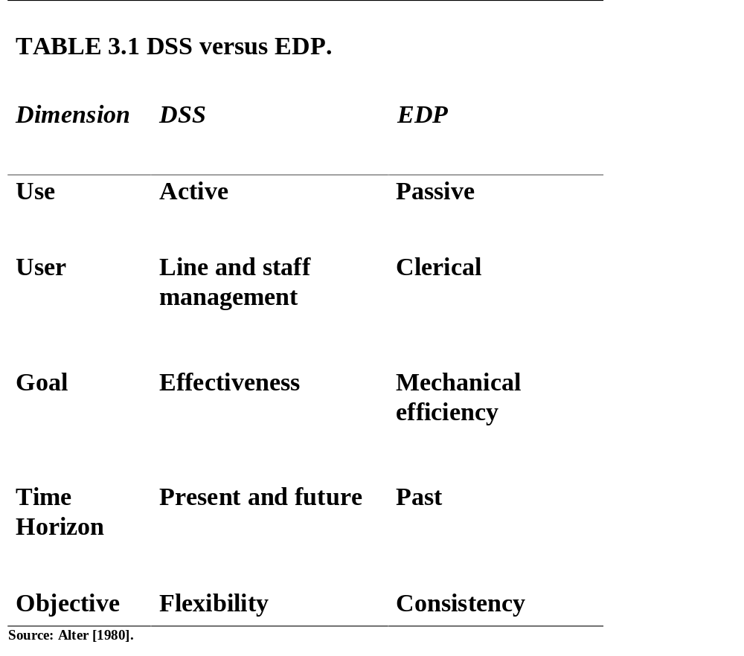
Decision Support Systems and Intelligent Systems, Efraim Turban and Jay E. Aronson, 6th edition
Copyright 2001, Prentice Hall, Upper Saddle River, NJ

Slide 7
Moore and Chang (1980)
1. Extendible systems
2. Capable of supporting ad hoc data analysis and
decision modeling
3. Oriented toward future planning
4. Used at irregular, unplanned intervals
Bonczek et al. (1980)
A computer-based system consisting of
1. A language system -- communication between the user and DSS components
2. A knowledge system
3. A problem-processing system--the link between the other two components
Decision Support Systems and Intelligent Systems, Efraim Turban and Jay E. Aronson, 6th edition
Copyright 2001, Prentice Hall, Upper Saddle River, NJ

Slide 8
Keen (1980)
DSS apply “to situations where a ‘final’ system can be developed only through an adaptive process of learning and evolution”
Central Issue in DSS
support and improvement of decision making
Decision Support Systems and Intelligent Systems, Efraim Turban and Jay E. Aronson, 6th edition
Copyright 2001, Prentice Hall, Upper Saddle River, NJ

Slide 9
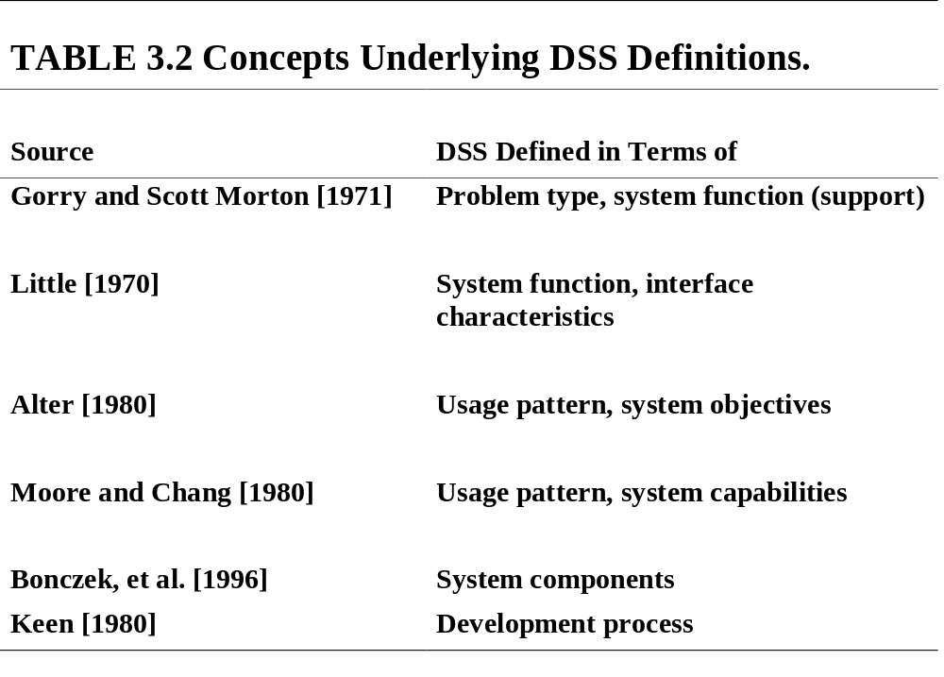
Decision Support Systems and Intelligent Systems, Efraim Turban and Jay E. Aronson, 6th edition
Copyright 2001, Prentice Hall, Upper Saddle River, NJ

Slide 10
Working Definition of DSS
A DSS is an interactive, flexible, and adaptable CBIS, specially developed for supporting the solution of a non-structured management problem for improved decision making. It utilizes data, it provides easy user interface, and it allows for the decision maker’s own insights
DSS may utilize models, is built by an interactive process (frequently by end-users), supports all the phases of the decision making, and may include a knowledge component
Decision Support Systems and Intelligent Systems, Efraim Turban and Jay E. Aronson, 6th edition
Copyright 2001, Prentice Hall, Upper Saddle River, NJ

Slide 11
Characteristics and Capabilities of DSS (Figure 3.1)
1. Provide support in semi-structured and unstructured situations, includes human judgment and computerized information
2. Support for various managerial levels
3. Support to individuals and groups
4. Support to interdependent and/or sequential decisions
5. Support all phases of the decision-making process
6. Support a variety of decision-making processes and styles
(more)
Decision Support Systems and Intelligent Systems, Efraim Turban and Jay E. Aronson, 6th edition
Copyright 2001, Prentice Hall, Upper Saddle River, NJ

Slide 12
7. Are adaptive
8. Have user friendly interfaces
9. Goal: improve effectiveness of decision making
10. The decision maker controls the decision-making process
11. End-users can build simple systems
12. Utilizes models for analysis
13. Provides access to a variety of data sources, formats, and types
Decision makers can make better, more consistent decisions in a timely manner
Decision Support Systems and Intelligent Systems, Efraim Turban and Jay E. Aronson, 6th edition
Copyright 2001, Prentice Hall, Upper Saddle River, NJ

Slide 13
DSS Components
1. Data Management Subsystem
2. Model Management Subsystem
3. Knowledge-based (Management) Subsystem
4. User Interface Subsystem
5. The User
(Figure 3.2)
Decision Support Systems and Intelligent Systems, Efraim Turban and Jay E. Aronson, 6th edition
Copyright 2001, Prentice Hall, Upper Saddle River, NJ

Slide 14
DSS Components
User
User Interface
KBS1
DBMS
MBMS
KBS2
KBS3

Slide 15
The Data Management Subsystem
DSS database
Database management system
Data directory
Query facility
(Figure 3.3)
Decision Support Systems and Intelligent Systems, Efraim Turban and Jay E. Aronson, 6th edition
Copyright 2001, Prentice Hall, Upper Saddle River, NJ

Slide 16
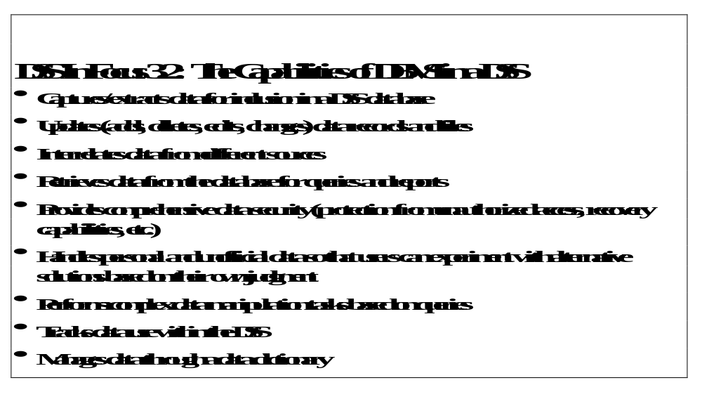
Decision Support Systems and Intelligent Systems, Efraim Turban and Jay E. Aronson, 6th edition
Copyright 2001, Prentice Hall, Upper Saddle River, NJ

Slide 17
DSS Database Issues
Data warehouse
Data mining
Special independent DSS databases
Extraction of data from internal, external, and private sources
Web browser data access
Web database servers
Multimedia databases
Special GSS databases (like Lotus Notes / Domino Server)
Online Analytical Processing (OLAP)
Object-oriented databases
Commercial database management systems (DBMS)
Decision Support Systems and Intelligent Systems, Efraim Turban and Jay E. Aronson, 6th edition
Copyright 2001, Prentice Hall, Upper Saddle River, NJ

Slide 18
The Model Management Subsystem
Analog of the database management subsystem
(Figure 3.4)
Model base
Model base management system
Modeling language
Model directory
Model execution, integration, and command processor
Decision Support Systems and Intelligent Systems, Efraim Turban and Jay E. Aronson, 6th edition
Copyright 2001, Prentice Hall, Upper Saddle River, NJ

Slide 19
Model Management Issues
Model level: Strategic, managerial (tactical), and operational
Modeling languages
Lack of standard MBMS activities. WHY?
Use of AI and fuzzy logic in MBMS
Decision Support Systems and Intelligent Systems, Efraim Turban and Jay E. Aronson, 6th edition
Copyright 2001, Prentice Hall, Upper Saddle River, NJ

Slide 20
The Knowledge Based (Management) Subsystem
Provides expertise in solving complex unstructured and semi-structured problems
Expertise provided by an expert system or other intelligent system
Advanced DSS have a knowledge based (management) component
Leads to intelligent DSS
Example: Data mining
Decision Support Systems and Intelligent Systems, Efraim Turban and Jay E. Aronson, 6th edition
Copyright 2001, Prentice Hall, Upper Saddle River, NJ

Slide 21

The User Interface (Dialog) Subsystem
Includes all communication between a user and the MSS
Graphical user interfaces (GUI)
Voice recognition and speech synthesis possible
To most users, the user interface is the system
Decision Support Systems and Intelligent Systems, Efraim Turban and Jay E. Aronson, 6th edition
Copyright 2001, Prentice Hall, Upper Saddle River, NJ

Slide 22
The User
Different usage patterns for the user, the manager, or the decision maker
Managers
Staff specialists
Intermediaries
1. Staff assistant
2. Expert tool user
3. Business (system) analyst
4. GSS Facilitator
Decision Support Systems and Intelligent Systems, Efraim Turban and Jay E. Aronson, 6th edition
Copyright 2001, Prentice Hall, Upper Saddle River, NJ

Slide 23
DSS Hardware
Evolved with computer hardware and
software technologies
Major Hardware Options
Mainframe
Workstation
Personal computer
Web server system
  Internet
  Intranets
  Extranets
Decision Support Systems and Intelligent Systems, Efraim Turban and Jay E. Aronson, 6th edition
Copyright 2001, Prentice Hall, Upper Saddle River, NJ

Slide 24
Distinguishing DSS from
Management Science and MIS
DSS is a problem-solving tool and is frequently used to address ad hoc and unexpected problems
Different than MIS
DSS evolve as they develop
Decision Support Systems and Intelligent Systems, Efraim Turban and Jay E. Aronson, 6th edition
Copyright 2001, Prentice Hall, Upper Saddle River, NJ

Slide 25
DSS Classifications
Alter’s Output Classification (1980)
Degree of action implication of system outputs (supporting decision) (Table 3.3)
Holsapple and Whinston’s Classification
1. Text-oriented DSS
2. Database-oriented DSS
3. Spreadsheet-oriented DSS
4. Solver-oriented DSS
5. Rule-oriented DSS
6. Compound DSS
Decision Support Systems and Intelligent Systems, Efraim Turban and Jay E. Aronson, 6th edition
Copyright 2001, Prentice Hall, Upper Saddle River, NJ

Slide 26
Intelligent DSS Categories
Descriptive
Procedural
Reasoning
Linguistic
Presentation
Assimilative
Decision Support Systems and Intelligent Systems, Efraim Turban and Jay E. Aronson, 6th edition
Copyright 2001, Prentice Hall, Upper Saddle River, NJ

Slide 27
Alternate Categories of Intelligent DSS
Symbiotic
Expert-system based
Adaptive
Holistic
Decision Support Systems and Intelligent Systems, Efraim Turban and Jay E. Aronson, 6th edition
Copyright 2001, Prentice Hall, Upper Saddle River, NJ

Slide 28
Other Classifications
Institutional DSS vs. Ad Hoc DSS
Institutional DSS deals with decisions of a recurring nature
Ad Hoc DSS deals with specific problems that are usually neither anticipated nor recurring
Decision Support Systems and Intelligent Systems, Efraim Turban and Jay E. Aronson, 6th edition
Copyright 2001, Prentice Hall, Upper Saddle River, NJ

Slide 29
Other Classifications (cont’d.)
Degree of nonprocedurality (Bonczek et al., 1980)
Personal, group, and organizational support (Hackathorn and Keen, 1981)
Individual versus group support systems (GSS)
Custom-made versus ready-made systems
Decision Support Systems and Intelligent Systems, Efraim Turban and Jay E. Aronson, 6th edition
Copyright 2001, Prentice Hall, Upper Saddle River, NJ

Slide 30
Summary
Fundamentals of DSS
Components of DSS
Major capabilities of the DSS components
Major DSS categories
Decision Support Systems and Intelligent Systems, Efraim Turban and Jay E. Aronson, 6th edition
Copyright 2001, Prentice Hall, Upper Saddle River, NJ

